Slide 1
Peer 2peer Activities
Serbia

Slide 2
Ngo IUVENTA
After training course in Pristina we organize several peer2peer activities in Serbia :
Centa(9.9.2018)
Bujanovac(19-20.9.2018)
Presevo(21-22.9.2018)

Slide 3
Centa
we gathered around 10 youngsters from rural area for 1. day to promote RYCO, project ,,You(th) inspiring others,,and also to speak about opptournities for youths in region and Europe.
Activities:
-presentation of RYCO
-project ,,You(th) inspiring others,,
-brainstorming intercultural dialogue
-intercultural learning
-open disscusion

Slide 4
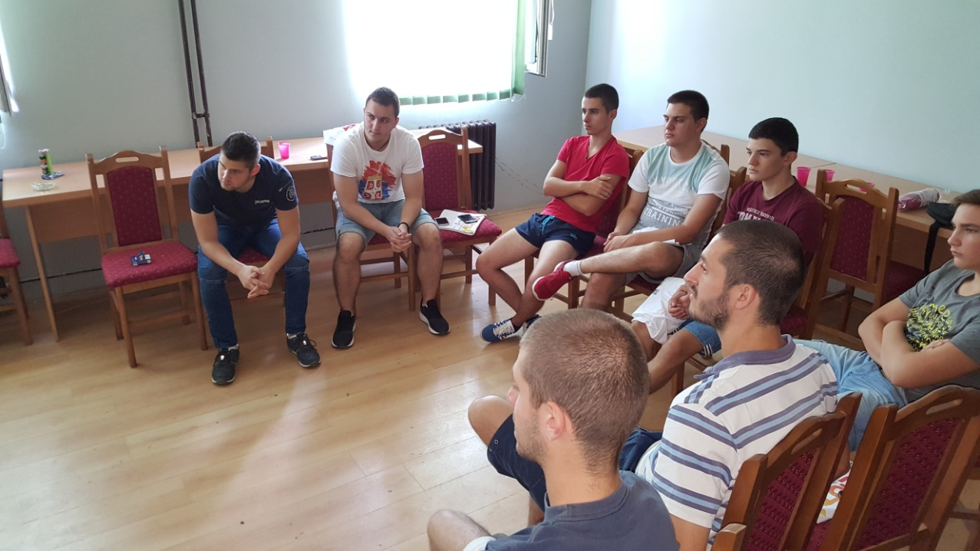
PEER
2
PEER

Slide 5
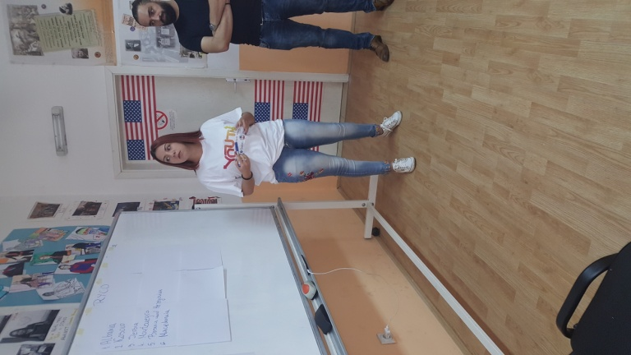
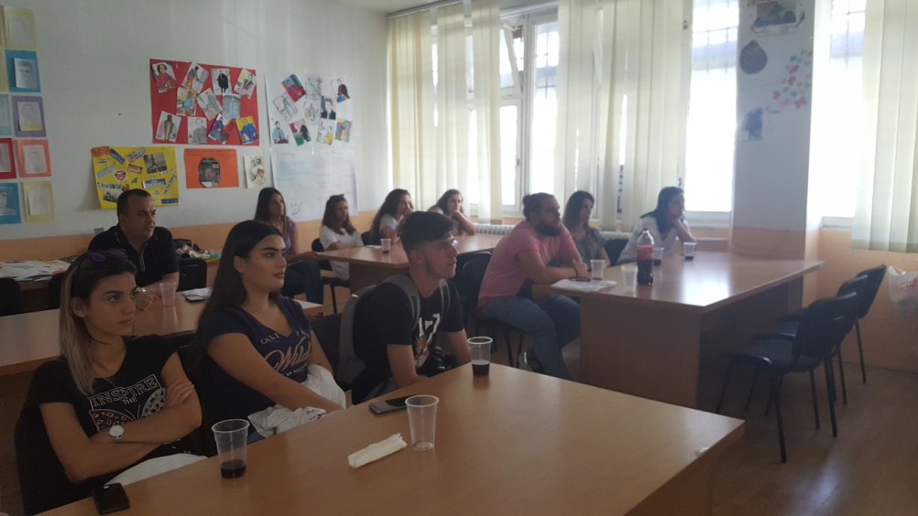
Bujanovac
At a first day we start the Peer-to-Peer (P2P) at the local level which was a multiplier effect of the training where the participants of the training have the opportunity to further develop their skills and to replicate the knowledge gained and to distribute in their new places at high schools.

Slide 6
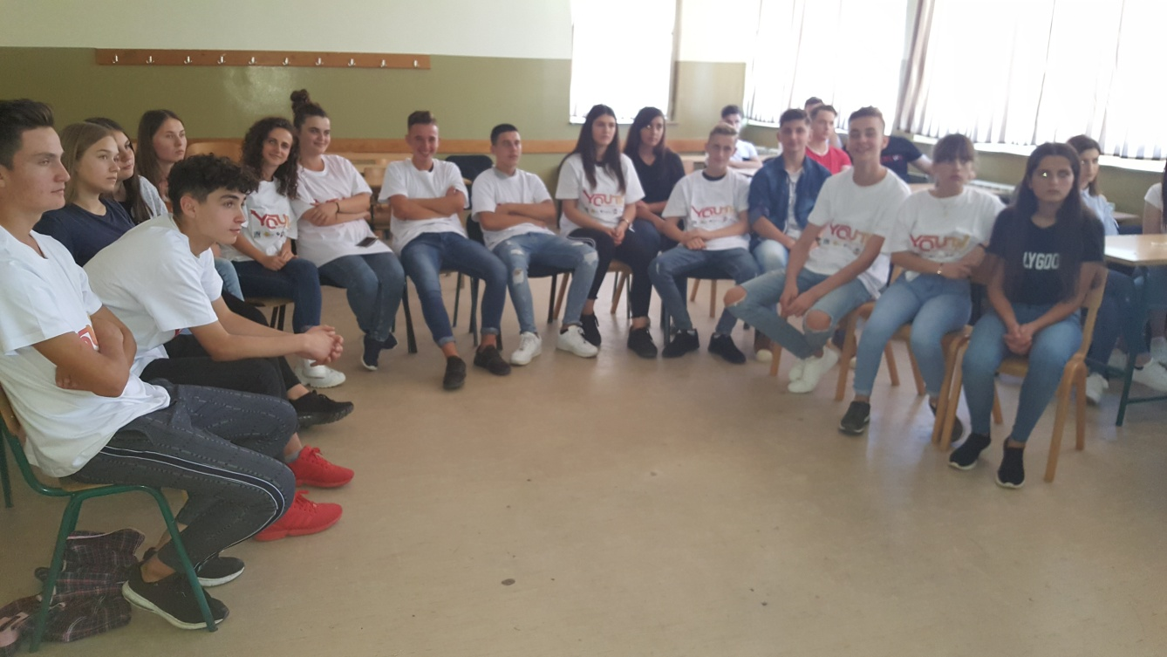
Activities
Presentation of RYCO and project
Intercultural learning
Intercultural dialogue in local community
Oppotrunities for youth on region and Europe

Slide 7
Presevo
Two days activities in Presevo gathered around 25 people from local comunuties.
Ater the successful implementation of the training, very motivated youngstairs from other Ngo-s, youth workers and interested people learned a lot about intercultural dialogue in region.

Slide 8
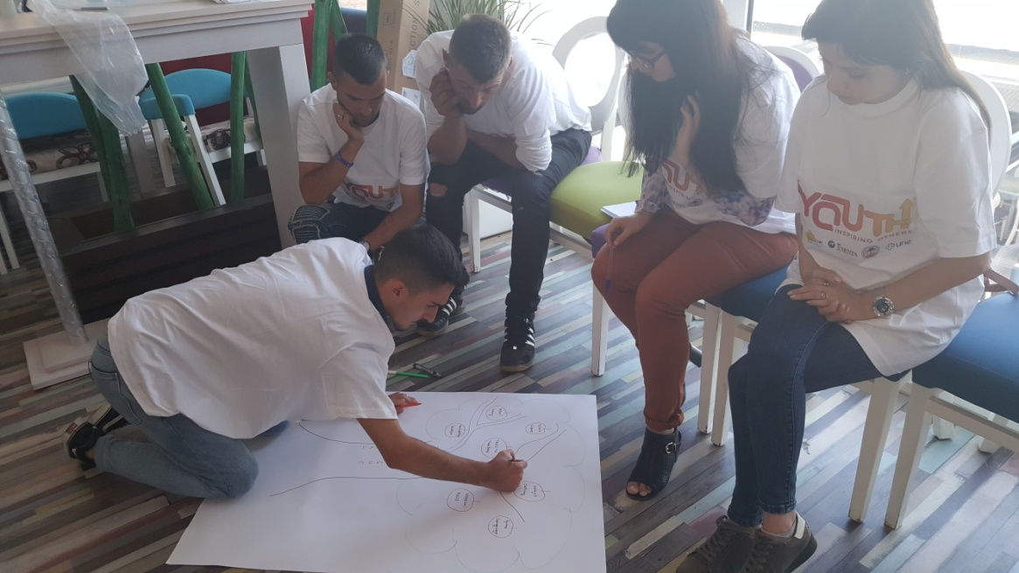
ACTIVITIES
Presentation about RYCO
Presentation of project and Ngo Iuventa
Intercultural learning and dialogue in region
Open disscusion about opportunities for youth
Sharing expiriences

Slide 9
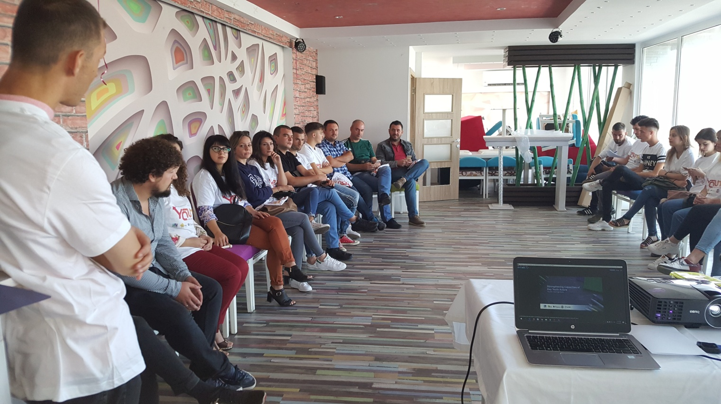
Main aim of the second day was to learn how to write project, project ideas and implementation in local community.

Slide 10
THANK YOU FOR ATENTION

